Slide 1

ECM Strategy for SharePoint
Notes:
Creating an ECM Strategy
Technology as a Service
Presented by Karuana Gatimu
February 18, 2009
Presentation Purpose: Review the steps for creating an Enterprise Content Management Plan

Slide 2
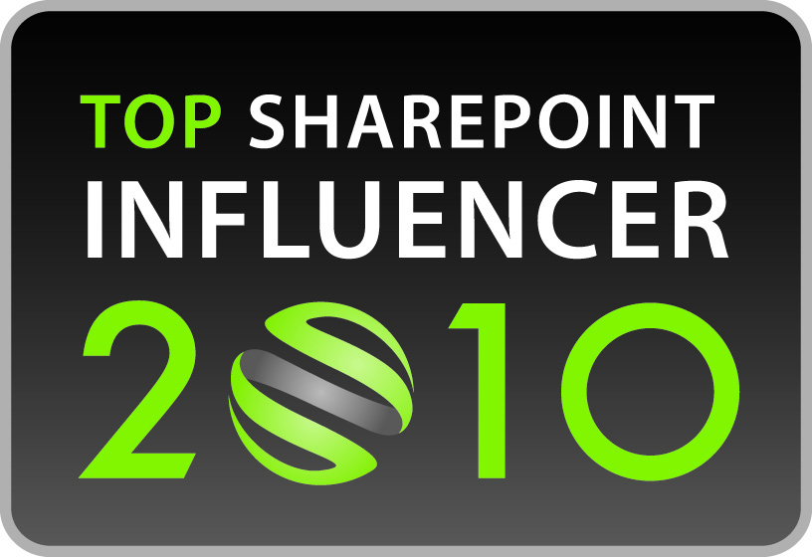
Who Am I?
Technology professional with 19 years experience in project management, custom application development, marketing and process engineering.
Certified Enterprise Content Management Practitioner
Currently Director, Marketing Operations & Chief SharePoint Architect for Skechers USA, a global footwear manufacturer
12 Years as a content management specialist for legal and government industries
Principal Enthusiast at SharePointStrategist.com; Co-Founder SPUGs.org
Nominated to SharePoint 50, Top Influencers List for consultants
Co-Chair, SharePoint Saturday Los Angeles

Slide 3
We are more than our data points!
→ An ECM Strategy is an opportunity to embrace change
→ Identify obstacles and old institutionalized habits
→ Making different communication choices will change the tenor of your project
→ Enhance communication & strategic clarity
→ Trust yourself to learn how to handle it differently

Slide 4

Change Agent
Embracing Change
Neutral
Resistance
Fear of Change
Neutral
Support
Nay Sayer
Notes:
Implementing a successful BI project in the real world requires that you embrace your role as a change agent:
Get class examples of each role.
What do you say to executive manager who refuses to give up his or her green bar reports?
How do you encourage people not to be afraid of the “new system”
Identify nay sayers – utilize tend & befriend techniques to minimize project impact
How do you leverage the enthusiasm of the visionary manager for whom this roll out can’t happen soon enough?
There will always be those neutral people who will watch what happens and jump on the bandwagon later.
Be prepared to handle this epheromal part of your project or nominate someone to do this when you select a project communications manager.

Slide 5
An ECM Strategy – Why You Need One
What Is It? An ECM Strategy document is an iterative document which outlines your requirements, approach & measurable goals for delivering ECM services to the enterprise.
→ Focus on Technology as a Service
→ It’s a Process not a Product
→ Evaluate Existing Systems & Processes
→ Start the Conversation – Engage Others
→ Find Your Pain Points
Notes:
A good Enterprise Content Management policy has approximately 10 moving parts. Each segment is a large discussion to have and/or collate from other corporate policies and discussions. The process of creating this document can be simple and more generic or detailed and very specific to your environment.
From this ECM Strategy you cull information for project planning, staffing needs, quality assurance measurements and other necessary project management performance indicators. It provides you with a foundation for thought and decision making in the future.
Start anywhere – revise frequently! It’s a process not a final deliverable and it’s always in flux.
The key to successful implementation is good communication, a focus on service and quality delivery.
Start small – dream big! Don’t bite off more than you can chew in a first project. SharePoint is meant to grow with your organization – CorasWorks will make that easy.

Slide 6
The Process – Vendor Independant
→ Gather your Strategy Team
→ Define your vision – Creating an ECM Strategy document
→ Gather information about each segment
→ Circulate & Iterate
→ Write & Review
Notes:
MSF Principles:
Work Toward a Shared Vision
Stay Agile – Expect Things to Change
Focus on Delivering Business Value
Foster Open Communication
SDLC Principles:
Initiation/Planning
Requirements Gatherings And Analysis
Design
Build or Coding
Testing
Operations and Maintenance
RUP Principles – Designed by IBM in 2003:
Use Case Centric
3 Building Blocks – Roles, Work Products & Tasks
4 Lifecycle Phases – Inception, Elaboration, Construction & Transition
6 Engineering Disciplines – Business Model, Requirements, Analysis & Design, Implementation, Test, Deploy
3 Supporting Disciplines – Change Mangement, Project Management, Work Product (Artifact)

Slide 7
A Word About Project Management
→ Understand Your Process: Whether you use the SDLC, MSF, RUP or a hybrid have a project management process
→ Establish Project Stakeholders: These executive level people will help you manage organizational change
→ Establish a Communication Plan! Know in advance how you will communicate about your project
→ Define Success: Find measurable goals and track your success. Create a feedback process for your users
→ Plan your Resources: Yes, even if you are a team of one have a resource plan
Notes:
MSF Principles:
Work Toward a Shared Vision
Stay Agile – Expect Things to Change
Focus on Delivering Business Value
Foster Open Communication
SDLC Principles:
Initiation/Planning
Requirements Gatherings And Analysis
Design
Build or Coding
Testing
Operations and Maintenance
RUP Principles – Designed by IBM in 2003:
Use Case Centric
3 Building Blocks – Roles, Work Products & Tasks
4 Lifecycle Phases – Inception, Elaboration, Construction & Transition
6 Engineering Disciplines – Business Model, Requirements, Analysis & Design, Implementation, Test, Deploy
3 Supporting Disciplines – Change Mangement, Project Management, Work Product (Artifact)

Slide 8
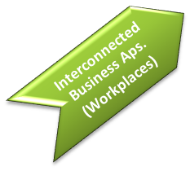

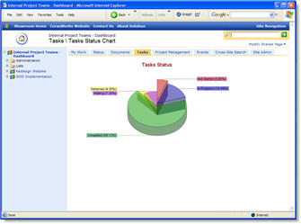
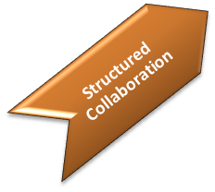
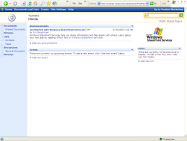
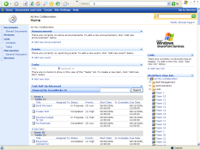
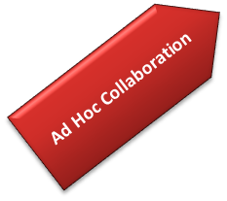


Getting There – A Virtual Workplace
Inter-connected Virtual Workplace
Business
Solutions
Business Value
Structured
Team
Sites
Ad-hoc
Team
Sites
Business Context
Notes:
As people deploy ECM software, how they use it use typically goes through up to 4 different phases
First, they start creating an environment for ad-hoc team sites. Each project team, or workgroup, creates a site where they store and track their own information. The challenge is that, over time, it becomes extremely difficult to find and work with information. And there is no easy way to consolidate information across different team sites, or to enable business processes across sites.
As a result, the second phase is what we think of as structured collaboration. A hierarchy of sites evolve over time, navigation within and across sites is added, and simple workflow processes are enabled.
In the third phase, portals are used for a specific business solution, such as an extranet, or a help desk solution, or a project management environment.
In the final phase, an organization deploys a workplace of interconnected business solutions, with automated business processes, management dashboards, and even integration with back end systems.

Slide 9
Capability Maturity Model (CMMI)
Optimizing
Initial
Defined
Managed
Measured
Body of Work Reference: Carnegie Mellon SEI
http://www.sei.cmu.edu/cmmi/general
Notes:
Note that the first application of a staged maturity model to IT was not by CMM/SEI, but rather Richard L. Nolan, who, in 1973 published the Stages of growth model for IT organisations. ^{[3]}
The model identifies five levels of process maturity for an organization:
Initial (chaotic, ad hoc, heroic) the starting point for use of a new process.
Repeatable (project management, process discipline) the process is used repeatedly.
Defined (institutionalized) the process is defined/confirmed as a standard business process.
Managed (quantified) process management and measurement takes place.
Optimising (process improvement) process management includes deliberate process optimization/improvement.
Within each of these maturity levels are Key Process Areas (KPAs) which characterise that level, and for each KPA there are five definitions identified:
Goals
Commitment
Ability
Measurement
Verification
The KPAs are not necessarily unique to CMM, representing — as they do — the stages that organizations must go through on the way to becoming mature.
Process assessment is best led by an appropriately skilled/competent lead assessor. The organisation's process maturity level is assessed, and then a specific plan is developed to get to the next level. Skipping levels is not allowed.

Slide 10
Challenges to Implementation
Technology as a Service
Architecture Design
Pilot Project Selection
ECM Strategy
IT Resources
Risk Analysis
Best Practices
Theory
Implementation

Slide 11

New vs. Existing Deployments
If you are new:
Think about an appropriate pilot project to cut your teeth on
Do not over commit or deploy all features at once
If you have an existing deployment:
Which segments can you enhance?
How are you delivering value to your users?
Which pieces of the strategy have you missed on previous projects & how can you improve?
Notes:
½ way mark

Slide 12
Architecture Considerations
Taxonomy - How you classify data as expressed through:
Database & web app design
Content types
Custom columns
Farm metadata store
Legacy Integration
Links to external databases & other LOB apps
Data Conversions
Unstructured to Structured Data
File Stores

Slide 13
Compliance & Governance
Information retention policy
Document & data life cycles
Legal (litigation & other requirements)
Executive management review/approval
Enterprise change management policies
SOX
HIPPA
Each consideration can be handled by defining metadata with associated workflows, audit trails, publishing sites, content expiration and a taxonomy that identifies the owners & categorization of content.

Slide 14
Compliance & Governance
Define the Information retention policies first
Document & data life cycles
Evaluate ECM Software to identify features & tools that will help you to implement & enforce your policies
Use visual workflow tools to show lifecycles
Show human interaction with system expirations
Add complexity by iteration

Slide 15
Fault Tolerance & Data Protection
Gain & maintain the trust of the enterprise to reliably safeguard their data
Hardware/Software levels
Backup & Maintenance Plans
Fire Drill Schedules & Emergency Procedures

Slide 16
Scalability
Immediate and future needs
Amortized costs
Hardware, licensing, service expenses

Slide 17
Institutional Knowledge Management
Resource
Allocation
Education of Internal Resources
Balance Internal & External Expertise
Long Term Planning

Slide 18
Cost & Risk Analysis
Pilot Project Selection
Budget
Define Business Case
Plan
Risk
Advise

Slide 19
Goals & QA
Goals by Quarter for MBO planning
Be careful what you publish!
Quality Assurance & Measuring
a. User feedback process
b. Revision criteria
c. Defined criteria for success
d. Iterative development processes
i. Prioritize feature roll outs by iteration

Slide 20
Resources
Web Resources:
Vendor Specific Information (Microsoft, Oracle, EMC)
SharePoint University
SharePointStrategist.com – my blog
Outline of ECM Strategy
Job Descriptions
MSF Framework links
Bloggers Universe
SharePoint Deployment & Governance Using Cobit by Dave Chennault
AIIM.org – ECM conference each year
Spugs.org – Connect to user groups

Slide 21
Questions & Comments

